Slide 1
Declarative Tracepoints (DT) - A programmable and Application independent Debugging System for WSN
Qing Cao, Tarek Abdelzaher(UIUC),
John Stankovic, Kamin Whitehouse (UVA),
Liqian Luo (MSR)

Slide 2
Outline
Requirements for debugging WSN
Existing techniques
Declarative Tracepoints Debugging System
Evaluation
Conclusions

Slide 3
Requirements for Debugging WSN
Watch program state to diagnose abnormal behavior
Watch the right variables at the right time
Visibility into program state
Resource constraints

Slide 4
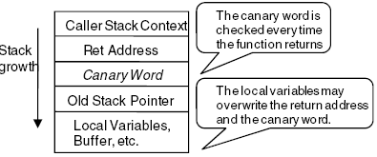
Existing Techniques
EnviroLog
Event recording and replay
Compiler modify source code to record function called time and parameter
START_RECORD, START_REPLAY
NodeMD
To diagnose node-level faults
Stack overflow, livelock, deadlock, application-specific faults
Sympathy
Trace the source of failure:
node, communication, sink
Collect metrics and analyze at the sink
StackGuard
Stack corruption, buffer overrun
Canary Word

Slide 5
Design of DT
Application-independent
No need of source level modification
Isolate debugging code from app code
Debugging without re-compilation or re-deployment
Programmable
TraceSQL debugging laguage, declarative similar to SQL
Location of tracepoints and associated actions
Trace yield() FROM syscall.c
Execution { RECORD yield();}
Where { READ msend->lock FROM radio.c == 1; }

Slide 6
Architecture of DT

Slide 7
TraceSQL Keywords

Slide 8
TraceSQL Example Of StackGuard

Slide 9
Code Examples

Slide 10
Implementation

Slide 11
LiteOS
Separate compilation of kernel and user apps
Applications as individual threads
Each thread has non-overlapping flash and RAM
Memory addresses of app provide by a .lss file generated from app
trace retrieval from nodes by LiteOS shell file copy command
Atmega128 processor support modifying binary code at runtime

Slide 12
Dynamic Tracepoint Instrumentation

Slide 13
tradeoffs
Tracepoint actions focus on global variable operations
Local variable needs compiler dependent analysis
Does not address compiler specific optimization

Slide 14
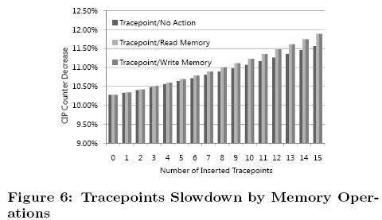
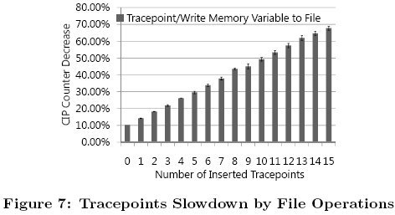
Evaluation--overhead
CPU slowdown
Memory Overhead
RAM: blank tracepoint(42bytes), file logging racepoint(332bytes)
Flash: increase with number of tracepoints, but < 4K with less than 15 tracepoints
Flash lifetime
File system:15 tps, hold 280 secs
Flash memory lifetime 10k write/erase cycles on MicaZ

Slide 15
TraceSQL expressiveness-EnviroLog

Slide 16
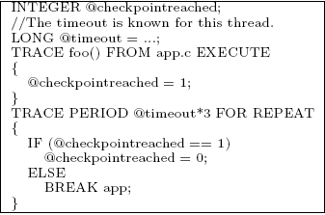
TraceSQL expressiveness-NodeMD

Slide 17
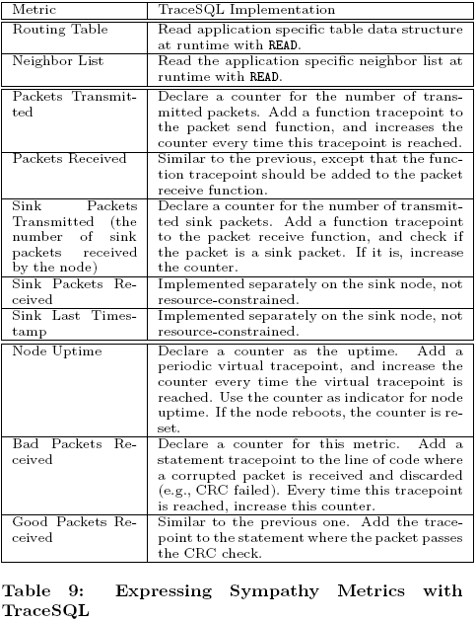
TraceSQL expressiveness-Sympathy

Slide 18
Case Studies
Bug 1: Node reboot after changing the compiler optimization level
Bug 2: User apps put into memory_corrupted state once executed
Bug 3: Unexpected corruption of communication protocol neighbor table

Slide 19
Conclusions
Declarative tracepoint debugging system
Application independent and programmable tracepoints at runtime
TraceSQL is expressive
Real case verification

