Slide 1
Surviving Sensor Network Software Faults
Yang Chen, John Regehr (U. Utah)
Omprakash Gnawali (USC)
Maria Kazandjieva, Philip Levis (Stanford)

Slide 2
Topics
Motivation
Idea
Implementation
Evaluation
Related Works
Conclusion

Slide 3
Motivation
Hardware/driver unreliability/unstable
Harvard Reventador Voltano Network downtime
SPI (serial peripheral interface) off-by-one bug, 1 developer one month, 30 hours of experiments on a controlled testbed with wired debugging backchannel
Memory violation
Reboot w/o losing precious data
Routing Info (CTP)
Link Status
Time Synchronization (FTSP)
App data (Tenet, app-level programming interface, data flow based)

Slide 4
Topics
Motivation
Idea
Implementation
Evaluation
Related Works
Conclusion

Slide 5
Idea of Neutron
Partial Reboot
Isolate soft components into rebootable units
Restore precious data or status
Reinitialize precious data when rebooting some unit
Requirements
Identify precious data
Identify fault unit
Reinitialize some data

Slide 6
Current Support
TinyOS
Single stack frame
Static compile & link
I/O callbacks (Commands, events), event trigger
Concurrent Model (Interruptions, tasks), FSMs for sys call
Safe TinyOS
Memory protection with Deputy compiler by static & dyn. Checks
Dependent type system (array bounds info in memory)
Actions: for debugging, display error with Leds; for deployment, reboot node
Safety violation should not be frequent otherwise node keep rebooting
TOSThreads
Preemptive threading lib (run all tasks in a single thread with highest priority)
TinyOS kernel thread (post message between kernel & TOSthread as tasks)
No diff from traditional uni-proccesor microkernel OS

Slide 7
Neutron Design

Slide 8
Topics
Motivation
Idea
Implementation
Evaluation
Related Works
Conclusion

Slide 9
Extensions to TinyOS

Slide 10
App Recovery Unit
No call between units
Each unit Instantiates at least one thread
nesC component above sys call belongs to at most one unit
nesC component below sys call belongs to kernel unit
Kernel unit has one thread

Slide 11
Isolating App Recovery Units
Namespace
Local state only accessible by interface
Analysis app component linking graph
Components interactions
Deputy’s memory safety
No pointer and array violation
Neutron statically prevents naming resources in app units, and dynamically prevents fabricating pointers and other backdoors

Slide 12
Safe termination
Termination safe (TOSThread)
Cancel sys calls & halt threads
Recaim dynamically allocated memory
Re-initialize app unit’s RAM
Restart unit’s threads

Slide 13
Kernel Recovery Unit
TinyOS, no virtual memory, non-volatile storage configured at compile time, limited shared state
App State
TOSThreads scheduler (the running thread, the kernel thread, the yielding thread), Ready queue, Counter of active app threads
Thread control blocks & stacks
Sys call structures
Sys call implementations
@syscall_base, @syscall_ext
Keep App Runnable
Cancel outstanding sys calls, protect app level kernel state
Cancel pending sys calls, reinitialize sys call structures

Slide 14
Implementation
Change TinyOS boot sequence
TinyOS: low level h/w, platform, s/w
Neutron: separate s/w initialization into kernel state and thread state, in reboot, thread state was skipped
Memory structures handled by thread state initialization
Any component needs maintained across kernel reboots register with initialization routing

Slide 15
Precious State
@precious() annotation
Apply to top level of a variable, not struct and union
Precious groups
Precious states with one single nesC component
Semantically dependent variables in same component
Forbidden pointers to refer: across precious groups, precious to non-precious data, precious into heap

Slide 16
Efficiency & Integrity
Avoid propagating corrupt precious data propagate to other units
Modified compiler to add .data (initialized) .bss (un-initialized) segments
Check precious variables for possible corruption
Push persisting vars on the stack
Copy initial values from ROM to the recovering .data section
Zero the recovering .bss section
Pop persisting vars, replace initial values

Slide 17
Topics
Motivation
Idea
Implementation
Evaluation
Related Works
Conclusion

Slide 18
Evaluation

Slide 19
Benefit: FTSP

Slide 20
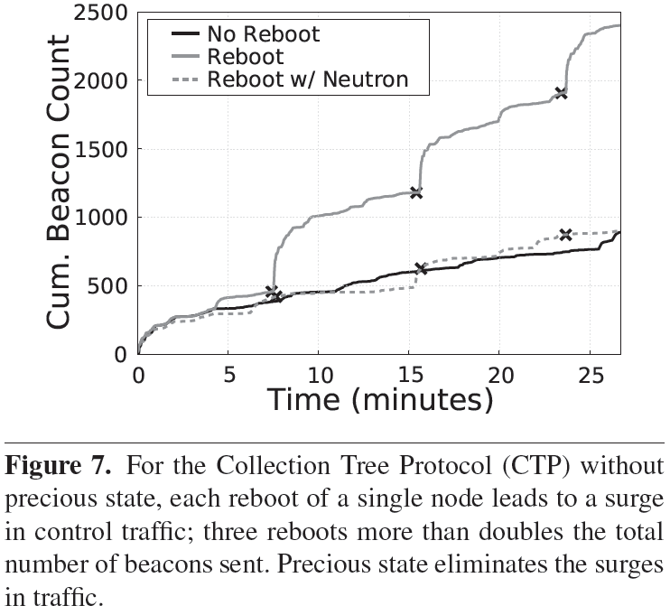
Benefit: CTP

Slide 21
Overhead

Slide 22
Reboot time

Slide 23
Reboot time

Slide 24
Topics
Motivation
Idea
Implementation
Evaluation
Related Works
Conclusion

Slide 25
Related Work
Language-based OS
Most use MMU to isolate processes
Singularity, KaffeOS, SPIN, type-safety by C#, Java, and Modula-3
SafeDrive, Nooks, rebootable exec environment
Reboot-based mechanisms for recovering
Microreboots for j2ee
Rx and recovery domains, checkpointing and re-execution, transaction rollback
Failure-oblivious computing, zero developer overhead
System support for persistent state
EROS, Grasshoper, KeyKOS, uniform interface to reboot-volatile and reboot-persistent storage
Rio Vista, persistent file cache with transaction library, swap partition

Slide 26
Topics
Motivation
Idea
Implementation
Evaluation
Related Works
Conclusion

Slide 27
Conclusion
Neutron uses conservative, compile-time techniques instead of exec rollback, re-exec, or transactional store
Resource limit
Assumptions
Memory faults are uncommon
Testing vs. deployment
Re-execution after cleanup will avoid the fault
Good match to TinyOS’s FSM-based interfaces and strongly decoupled components

Slide 28
Question?

