Slide 1


BOSS: Building Operating System Services
Stephen Dawson-Haggerty, Andrew Krioukov, Jay Taneja, Sagar Karandikar, Gabe Fierro, Nikita Kitaev, and David Culler
Computer Science Division
University of California, Berkeley
© 2013 All rights reserved

Slide 2
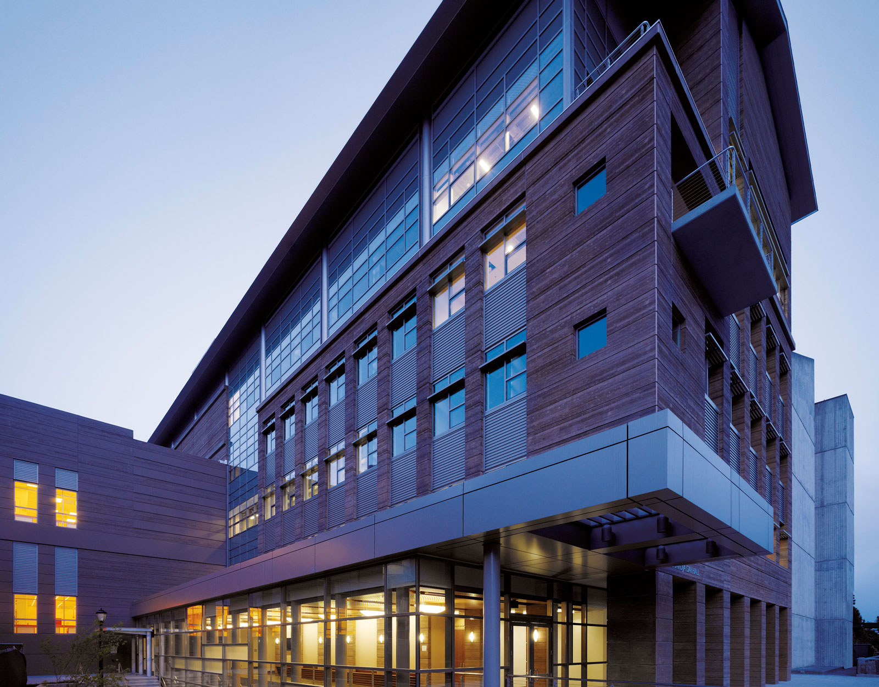
Sutardja-Dai Hall
UC Berkeley
93,000 sq. ft.
with Digital Controls
73% of US electricity is consumed in buildings
U.S. Energy Information Administration, 2009
2/3 of building occupants are uncomfortable
UC Berkeley CBE Study of 30,000 occupants
>70% of large buildings have digital controls

Slide 3

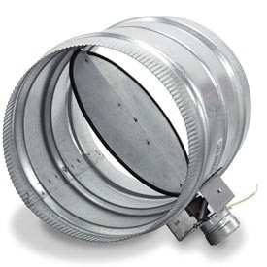



12 Variable Speed Fans
138 Air Dampers
312 Light Relays
> 6,000 Sense and Control Points
50 Electrical Sub-meters
151 Temperature Sensors
Notes:
Distributed networks with control over physical spaces

Slide 4
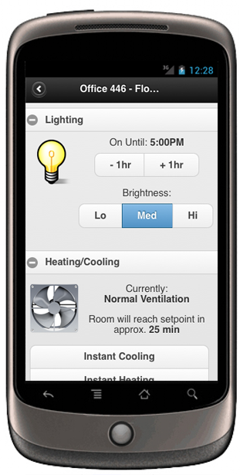
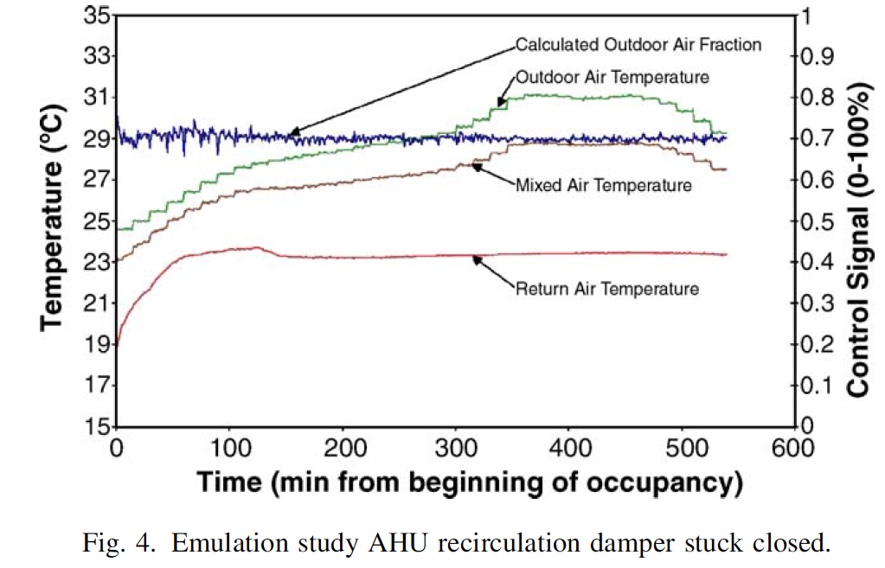
Applications
Ventilation Optimization:
17% energy savings
Occupant Lighting Controls
50-60% savings
Automated Fault Detection:
10 - 40% energy savings

Slide 5
Goals and Challenges
Portability
  Write once, run anywhere for buildings?
  Current practice: hand-coded logic
Fault tolerance
  Partial failures of controllers
  Network partitions
  Current practice: really tough hardware
Multiple processes
  Concurrent applications and users
  Current practice: none
Federation
  Multiple heterogeneous systems
  Current practice: lots of stovepipes
Scale
Security & privacy

Slide 6
BOSS: Building Operating System Services
Control processes
Fault tolerance
Isolation + Scheduling
“Kernel” interface
Security
Auth.
Time-series
Trans. mgr.
History
Hardware Abstraction Layer
Abstraction
HPL
HPL
HPL
HPL
Notes:
HPL = Hardware Presentation Layer = sMAP
Decomposition onto hardware is important – the transaction manager needs to be in the building, for instance.

Slide 7
Technologies in BOSS
Python
Some C for performance critical parts
RESTful
JSON
DNS naming for finding services
All data is within a shared global namespace
Propriety DB and Spatial DB
Approximate query language to select components
ETL for cleaning and filtering
Notes:
ETL = Extract Transform

Slide 8
Analytics side note
“Finally, there has previously been a separation between analytics, which deal with historical data, and control systems, which deal with real-time data. We demonstrate how to treat these uniformly in this environment, and present a time series service which allows applications to make identical use of both historical and real-time data.”

Slide 9
BOSS: Building Operating System Services
Elevates plethora of sensors and actuators to RESTful level
Places all data within global namespace.
Control processes
Fault tolerance
Isolation + Scheduling
“Kernel” interface
Security
Auth.
Time-series
Trans. mgr.
History
Hardware Abstraction Layer
Abstraction
HPL
HPL
HPL
HPL
Notes:
HPL = Hardware Presentation Layer = sMAP
Decomposition onto hardware is important – the transaction manager needs to be in the building, for instance.

Slide 10
BOSS: Building Operating System Services
Semantic modeling to describe relationship between sensors, actuators, and equipment
Control processes
Fault tolerance
Isolation + Scheduling
“Kernel” interface
Security
Auth.
Time-series
Trans. mgr.
History
Hardware Abstraction Layer
Abstraction
HPL
HPL
HPL
HPL

Slide 11
BOSS: Building Operating System Services
Real-time access to all sensors, and
Historical data
Provides analytical operators for cleaning and processing data
Control processes
Fault tolerance
Isolation + Scheduling
“Kernel” interface
Security
Auth.
Time-series
Trans. mgr.
History
Hardware Abstraction Layer
Abstraction
HPL
HPL
HPL
HPL

Slide 12
BOSS: Building Operating System Services
Robust and safe interface for external processes
Provides all or nothing, recovery, roll-back
Defines fault domains
Control processes
Fault tolerance
Isolation + Scheduling
“Kernel” interface
Security
Auth.
Time-series
Trans. mgr.
History
Hardware Abstraction Layer
Abstraction
HPL
HPL
HPL
HPL

Slide 13
BOSS: Building Operating System Services
Control processes
Fault tolerance
Isolation + Scheduling
“Kernel” interface
Security
Auth.
Time-series
Trans. mgr.
History
Hardware Abstraction Layer
Abstraction
HPL
HPL
HPL
HPL
Notes:
HPL = Hardware Presentation Layer = sMAP
Decomposition onto hardware is important – the transaction manager needs to be in the building, for instance.

Slide 14
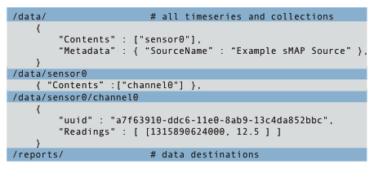
Hardware Presentation Layer (HPL)
Read and Write the point
Subscribe to changes
Receive periodic notifications about the value
Retrieve and Append metadata

Slide 15
Hardware Presentation Layer (HPL)
sMAP hides complexity and diversity
Everything is a point
Points become time series (streams)
Buffering
Leasing
Discovery
  Key-value pairs describes the data
Aggregation

Slide 16
BOSS: Building Operating System Services
Control processes
Fault tolerance
Isolation + Scheduling
“Kernel” interface
Security
Auth.
Time-series
Trans. mgr.
History
Hardware Abstraction Layer
Abstraction
HPL
HPL
HPL
HPL

Slide 17
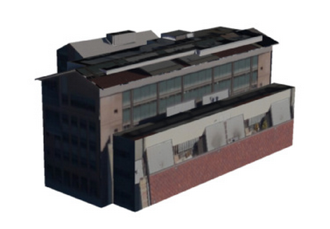
Hardware Abstraction Layer (HAL)
Buildings are custom designed
Challenge: Portability
Notes:
unique shape, layout, heating, ventilation, air conditioning, lighting and electrical system.

Slide 18
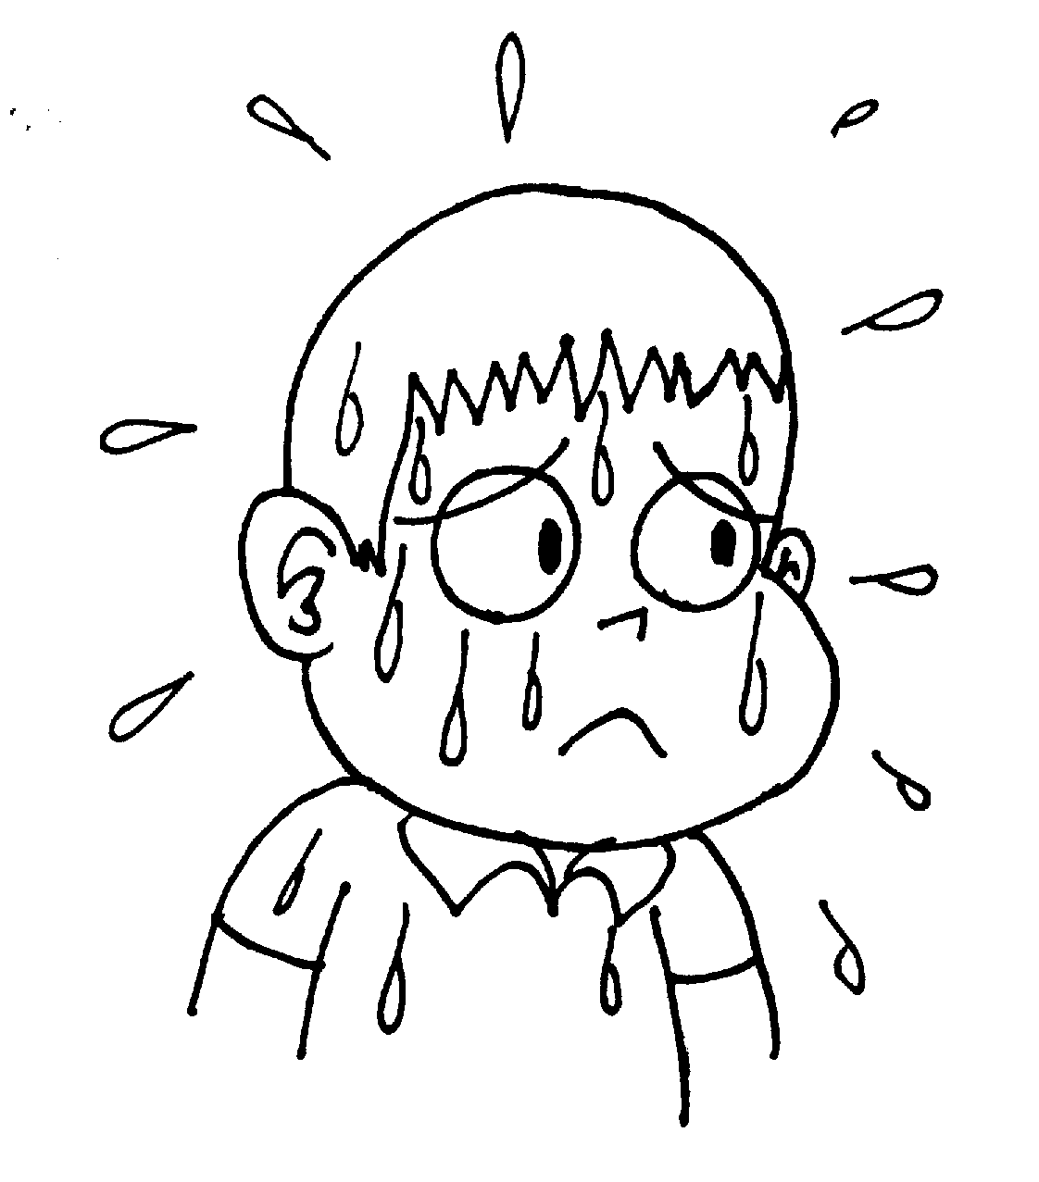
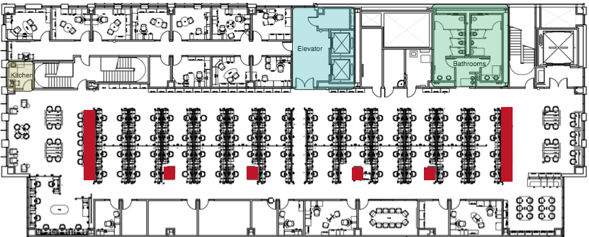
Hardware Abstraction
Physical view
Open area 450
Notes:
Personalized microclimate app

Slide 19
Hardware Abstraction
Systems View
VAV S4-21
Notes:
VAV = Variable Air Volume

Slide 20
Hardware Abstraction
Controls view
Air
Damper
Reheat coil
Controller
SDH.MEC-08.S4-21:DMPR COMD
device: 220018 instance: 101
SDH.MEC-08.S4-21:VLV COMD
device: 220018 instance: 102
BACnet
Notes:
The level at with existing application operate

Slide 21
legacy solution: encode everything in point name
SDH.MEC-08.S5-01.AIR_VOLUME
quantity being measured
S: VAV, 5: 5th floor, 01: the 1st one
MEC: Modular Equipment Controller #8
building name

Slide 22
Hardware Abstraction Layer (HAL)
Query language:
lights in room 410
Supports spatial queries
Uses graphs to describe Electrical distribution, HVAC mechanical interactions, and Lighting
Drivers in the HAL layer provide common methods:

Slide 23
Hardware Abstraction Layer (HAL)
Drivers in the HAL layer provide common methods:
set_speed
set_temperature
implemented using control loops over HPL points

Slide 24
Hardware Abstraction Layer
Program applications in terms of relationships between system components
  “it gets too hot on the sunny side”
Allow for scale by avoiding hard-coding
  “Run this in every room, except those on the north side”

Slide 25
BOSS: Building Operating System Services
Control processes
Fault tolerance
Isolation + Scheduling
“Kernel” interface
Security
Auth.
Time-series
Trans. mgr.
History
Hardware Abstraction Layer
Abstraction
HPL
HPL
HPL
HPL
Notes:
Functional components, interfaces, concerns.
Also the decomposition onto hardware is important – the transaction manager needs to be in the building, for instance.

Slide 26
BOSS solution: “transactions”: write access to the building
Writes to distributed resources
Which interact in physical space
Which are subject to failure
How to keep buildings safe despite app developers?
BOSS solution: Extend writes with
  Priorities
  Leases
  Notifications
  Reversion sequences

Slide 27
Transaction
Coordinate writes across multiple points
During Lease time all actions are valid
Revert sequence How to undo action
Error policy What to do in partial failure

Slide 28
BOSS: Building Operating System Services
Control processes
Fault tolerance
Isolation + Scheduling
“Kernel” interface
Security
Auth.
Time-series
Trans. mgr.
History
Hardware Abstraction Layer
Abstraction
HPL
HPL
HPL
HPL

Slide 29
Authorization
Problem with building supervisors
General need for security
BOSS Solution
  only lights on the fourth floor
  cannot dim the lights below 50%
  access only provided at night
Checks on individual points and each method call
Two stage authorization process

Slide 30
Future work
Control systems + CS future work
  Making use of the torrent of data?
  Compile/enforce constraints into the network?
  How to verify applications are behaving?

Slide 31
Question and answers

Slide 32
More BOSS
sMAP Hardware Presentation Layer
  30 Drivers, 30k data streams
Archiver data storage service
  500 writes/sec
  Stream cleaning and processing
Family of apps
  Personal ventilation and lighting control
  Electric grid-aware consumption
Name | Sensor Type | Access Method | Channels
ISO Data | CAISO, NYISO, PJM, MISO, ERCOT | Web scrape | 1211
ACme devices | Plug-load electric meter | Wireless 6lowpan mesh | 344
EECS submetering project | Dent Instruments PowerScout 18 electric meters | Modbus | 4644
EECS steam and condensate | Cadillac condensate; Central Station steam meter | Modbus/TCP | 13
UC Berkeley submetering feeds | ION 6200, Obvius Aquisuite; PSL pQube, Veris Industries E30 | Mosbus/Ethernet, HTTP | 4269
Sutardja Dai, Brower Hall BMS | Siemens Apogee BMS, Legrand WattStopper, Johnson Control BMS | BACnet/IP | 4064
UC Davis submetering feeds | Misc., Schneider Electric ION | OPC-DA | 34 (+)
Weather feeds | Vaisala WXT520 rooftop weather station; Wunderground | SDI-12, LabJack/Modbus, web scrape | 33
CBE PMP toolkit | Dust motes; New York Times BMS | CSV import; serial | 874

Slide 33
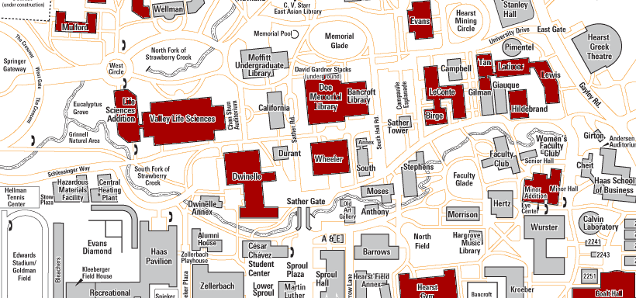
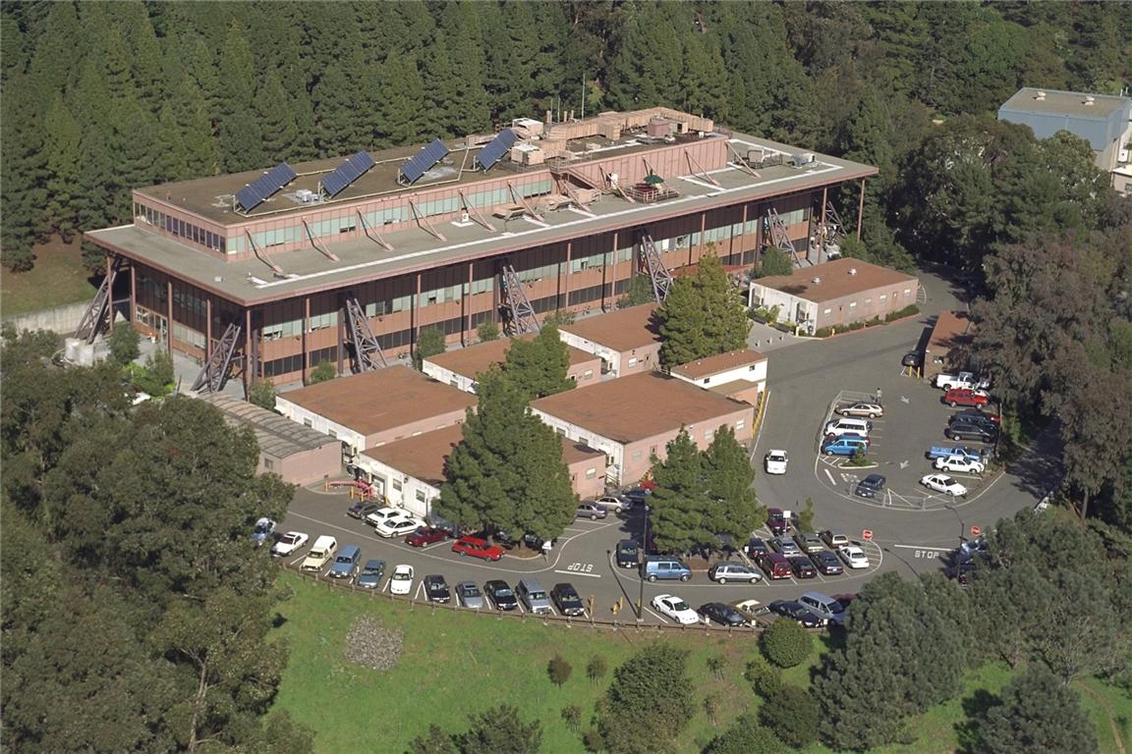
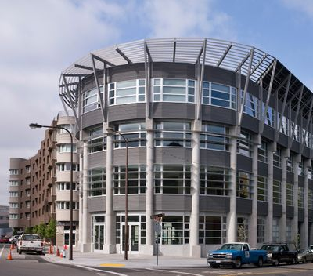
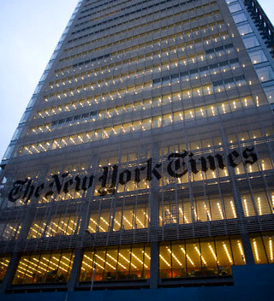

Slide 34
Takeaways
Applying computer systems design to buildings: lots of pieces, potential
  Control systems
  Mechanical systems
  Occupants
30% electricity + steam savings, 60% lighting savings in test apps
Many pieces at http://smap.cs.berkeley.edu
Control systems + CS future work
  Making use of the torrent of data?
  Compile/enforce constraints into the network?
  How to verify applications are behaving?
Notes:
A lot of the work on SDNs/constraint checking/policy enforcement seems relevant

Slide 35
Write applications in terms of relationship between hardware elements

Slide 36
BOSS
a collection of services enabling portable, robust applications for the physical environment
Hardware presentation layer: sMAP
Hardware abstraction layer: device-specific logic
Time-series service: the archiver
Reliable control inputs: the transaction manager
Security: the authorization service

Slide 38
writer 1 value: 69F
69
writer 2 value: 73F
73
No arbitration between applications
Orphaned writes

Slide 39
Command Sequence
Set damper to 100% open
Set valve to 0% open
… wait 10 minutes
Reset to “whatever was happening before”
What if…
#1 or #2 fail?
Client fails/becomes partitioned during #3?
Another application tries to do something?

Slide 40
BOSS solution: “transactions”
73
1
Extend writes with
  Priorities
  Leases
  Notifications
  Reversion sequences
69
writer 1 value: 69F priority: 3 lease: 3600s
overridden!
priority array
writer 2 value: 73F priority: 1 lease: 300s
<time passes>
writer 2 clear
writer 1 crashes
… writer 1 revert sequence runs
71
16
present value: 69cfm
present value: 73cfm

Slide 41
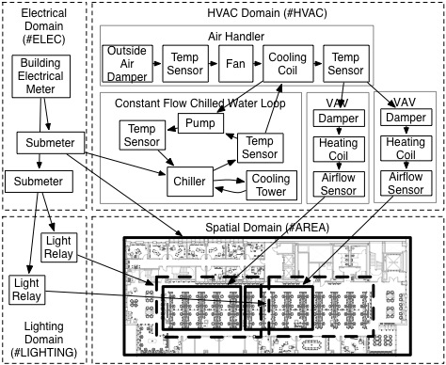
Hardware Abstraction Layer
#VAV > $(120, 20)
Notes:
Capture Functional, spatial relationships
Driver instance, Objects, Domain
Names, tags

