Slide 1
CSE 521S Course Projects - AWS IoT Tutorial
TA for class CSE 521S, Spring, Jan/19/2017
Haoran Li

Slide 2
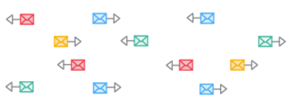
Internet-of-Things
Things (Devices)
Many of them
Different Types
Isolated Systems
Data and Command
Sensing the world
Give Response
Challenge
United: Connected + Communication
Smart: Data Analytics + Strategy
Source: https://aws.amazon.com/iot-platform/
http://www.brain-smart.net/smart-brain-health-blog/page/2/#axzz4W4oSp8a6

Slide 3
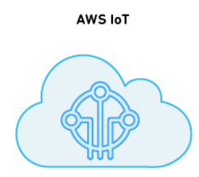
Solution: AWS IoT
United: Connect + Communication
Smart: Other Cloud Service
Data Storage
Machine Learning
Source: https://aws.amazon.com/iot-platform/

Slide 4
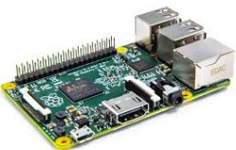
Tutorial: Hello AWS IoT!
Random
Integer
[1, 100]
>50 : ON
<=50: OFF
LED
Publish
Forward
Subscribe
Amazon SNS
Source: https://aws.amazon.com/iot-platform/

Slide 5
Step 1: Create a Virtual "Thing”
AWS IoT
Virtual “Thing” / Shadow

Slide 6
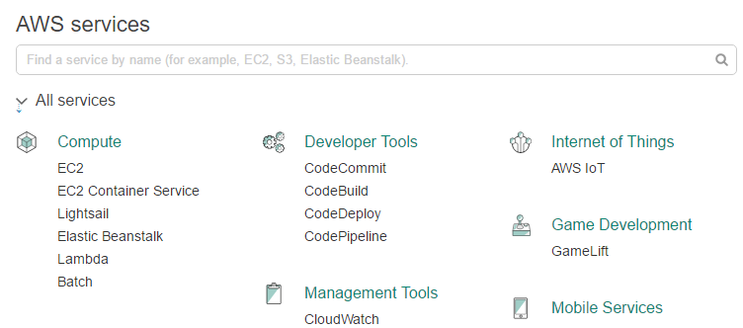
Get into AWS Manage Console
Create your own AWS account
Sign In IoT Manage Console
https://aws.amazon.com/iot/

Slide 7
Create a thing
1. AWS IoT Menu
Registry
Things ➔ Create
2. Give a name

Slide 8
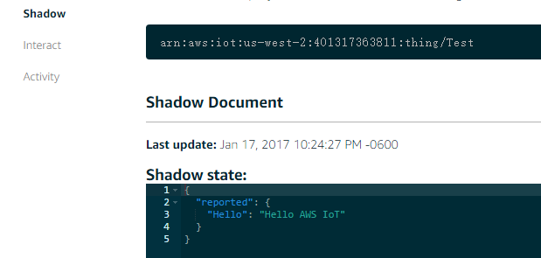
Basic Interact: Publish
Using Embedded MQTT Client to Test
Check the Things Shadow

Slide 9
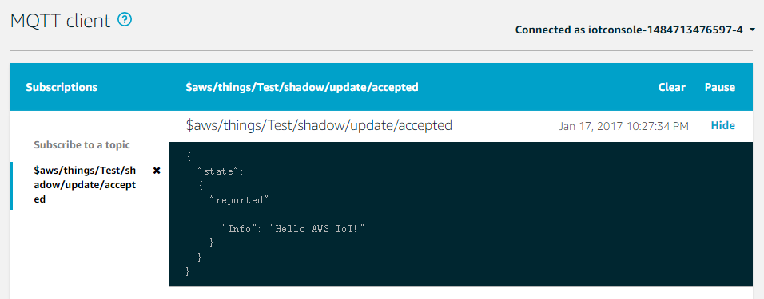
Basic Interact: Subscribe

Slide 10
Step 2: Connect a Physical Device
AWS IoT
MQTT Tools
Certificate
Virtual “Thing” / Shadow
Attach
Copy
Policy

Slide 11
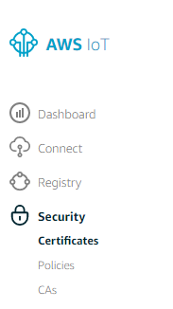
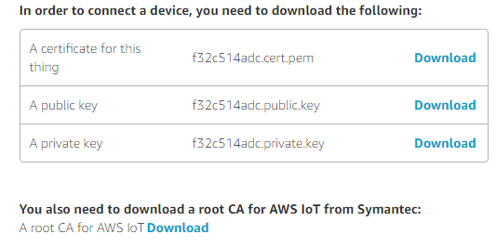
Create and get Certificates
Create Certificates
Security ➔ Certificates ➔ Create
Download Cert Files
1. public & private key
2. thing cert
3. Root CA for AWS

Slide 12
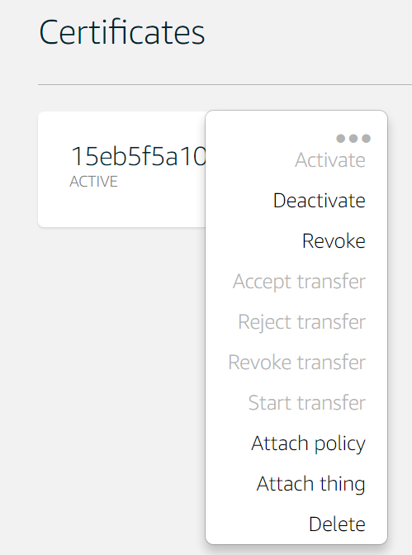
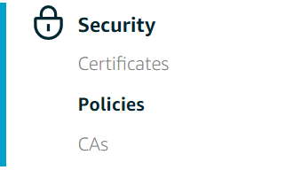
Create Policy and attach it to cert
Create Policy
Attach Policy to Certificates

Slide 13
Connect your Device
Copy certificates to RP2
Choose your AWS SDK (support MQTT)
Node JS
Python
Java
Embedded C
You can also use third party MQTT tools
Python (paho mqtt library)

Slide 14
Some Notes
1. You will need these certification when setting up the TLS1.2 verification
2. You will need the endpoint and port (8883) when connect to AWS IoT Gateway

Slide 15
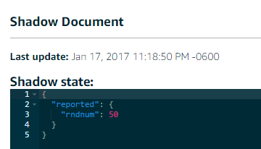
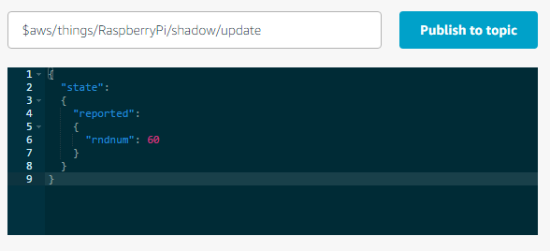
Publish / Subscribe
Publish
payload = "{\"state\":{\"reported\":{\"rndnum\":50}}}"
Subscribe

Slide 16
Step 3: Push Button and Publish
Random
Integer
[1, 100]
Publish

Slide 17
Step 4: Subscribe and Lit up LED
>50 : ON
<=50: OFF
LED
AWS IoT
Online MQTT
Client
Virtual “Thing” / Shadow
Subscribe
Publish

Slide 18
Step 5: Combine Them Together
Random
Integer
[1, 100]
>50 : ON
<=50: OFF
LED
Publish
Subscribe

Slide 19
More Fancy: SNS services
Simple Notification Service
AWS IoT
Publish
Virtual “Thing” / Shadow
Subscribe
Forward
Subscribe
My Topic
Subscribe
Amazon SNS

Slide 20
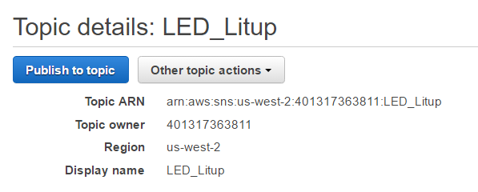
Amazon SNS
Create a Topic
ARN will be used
later
Subscribe your cellphone and email to this topic

Slide 21
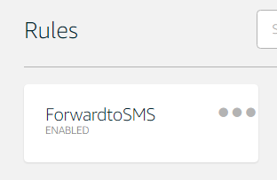
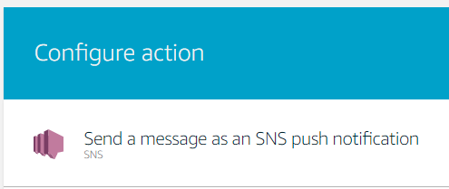
Create a Rule in Amazon IoT
Add a query to filter your inteseting topic (event)
Add an Action:
Forward this message to SNS
Specify Dest ARN
Enable Rule

Slide 22
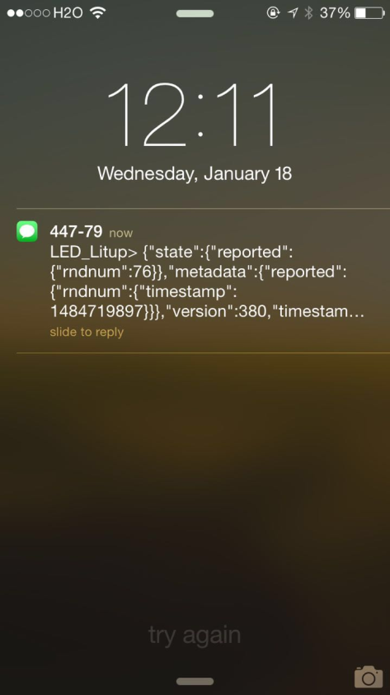
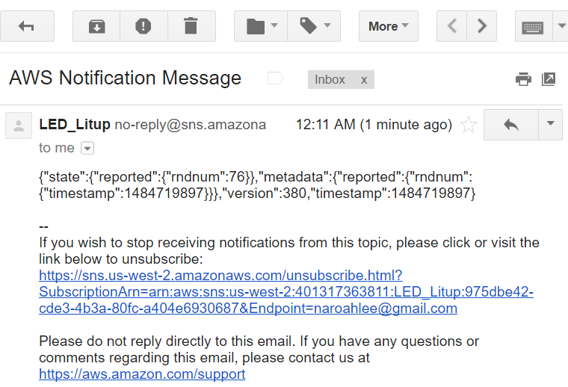
Notification on SMS & Email

Slide 23
Recap: Hello AWS IoT!
Random
Integer
[1, 100]
>50 : ON
<=50: OFF
LED
Publish
Forward
Subscribe
Amazon SNS
Source: https://aws.amazon.com/iot-platform/

Slide 24
Recap: Amazon IoT Architecture

Slide 25
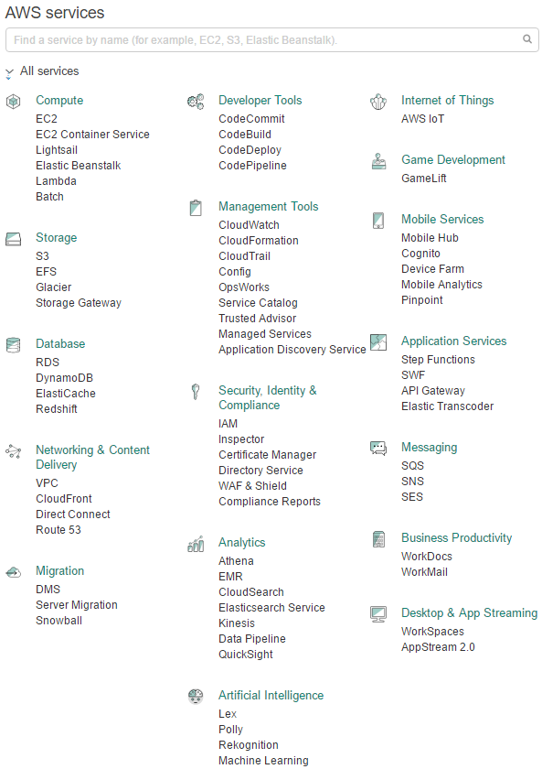
Be Creative!
Bunch of Services
Embedded systems + Cloud Services…
IoT!

Slide 26
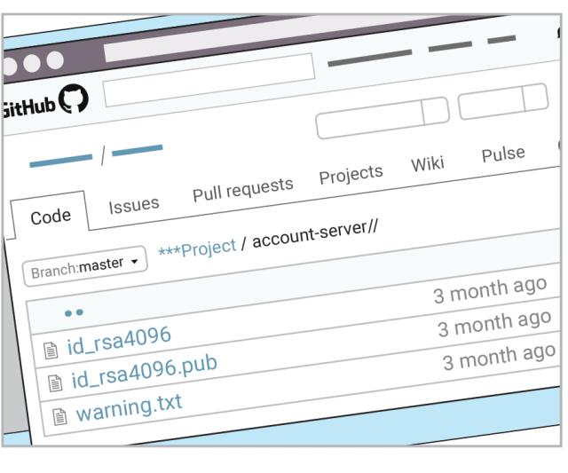
One More Thing: Security
DON’T UPLOAD YOUR PUBLIC KEY!!!
Time to Open Source!
Source: WeChat Subscriptions: 西乔《神秘的程序员们 39》 Geek Life Chpt 39.

Slide 27
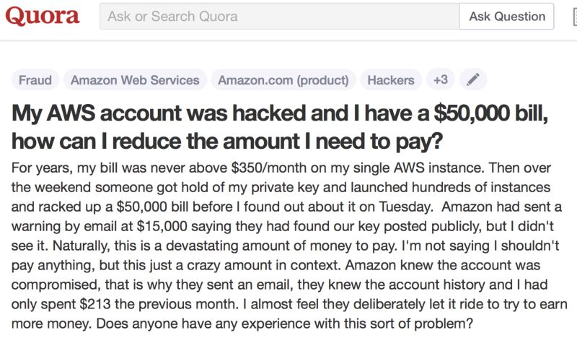
What if… 50,000 AWS Bill!
Source: https://www.quora.com/My-AWS-account-was-hacked-and-I-have-a-50-000-bill-how-can-I-reduce-the-amount-I-need-to-pay

Slide 28
Pointers
Amazon IoT
http://docs.aws.amazon.com/iot/latest/developerguide/what-is-aws-iot.html
Amazon SNS
http://docs.aws.amazon.com/sns/latest/dg/welcome.html
AWS Resource list for course projects
http://cps.cse.wustl.edu/index.php/AWS_Resources
Apply for $40 credits for Amazon AWS
https://aws.amazon.com/education/awseducate/apply/

Slide 29
Project Requirements
Run in public cloud
Difficulty varies for listed candidates - will take difficulty into consideration when grading.
Will grade based on
project difficulty
quality and depth of work
workload distribution among team members
Milestones: proposal, demo1, demo2, final demo, report.
Start early! Discuss with us and Dr. Lu

Slide 30
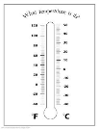
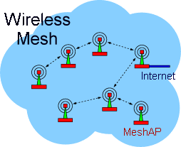
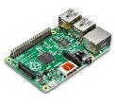
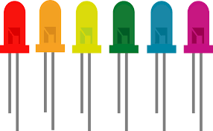
Example: Smart House Keeper
Temperature/Humidity Sensor
Camera System
RealTime
Monitor
LED

Slide 31
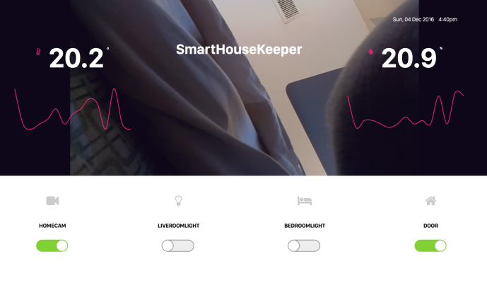
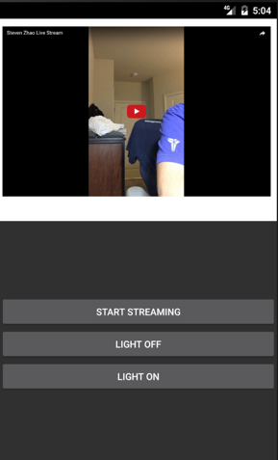
Final Project
Integrated everything with webpage dashboard
RealTime Live Stream
RealTime Temperature and Humidity Monitor
Remotely Light Control
Virtual Control Over Door
Android App: Live Streaming and Light Control

