Slide 1
Implementation of Decentralized Damage Localization in Wireless Sensor Networks
Fei Sun
Master Project
Advisor: Dr. Chenyang Lu

Slide 2
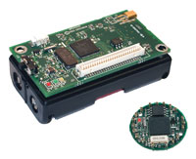
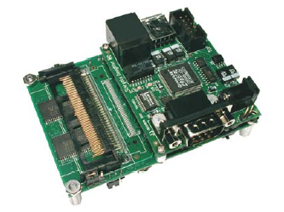
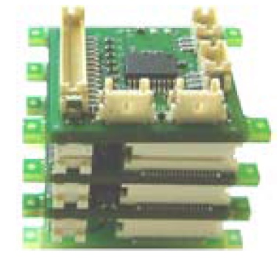
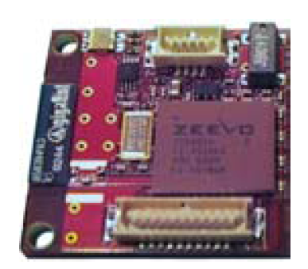
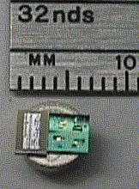
Wireless Sensor Network
Mica2 & Mica2dot
Tmote Sky
Stargate
NMRC 25mm cube
Intel iMote
Smart Dust

Slide 3
Structural Health Monitoring
A Civil Engineering technique used to determine the condition of structures
  e. g. buildings, bridges
Detect and localize damage using vibration sensors

Slide 4
Motivation and Challenges
Wired sensor deployment is expensive
Wireless deployments can be:
  Cost efficient
  Higher density
  More flexible

Slide 5
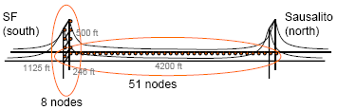
Related Work - Golden Gate Bridge
GGB project by UC Berkley

Slide 6
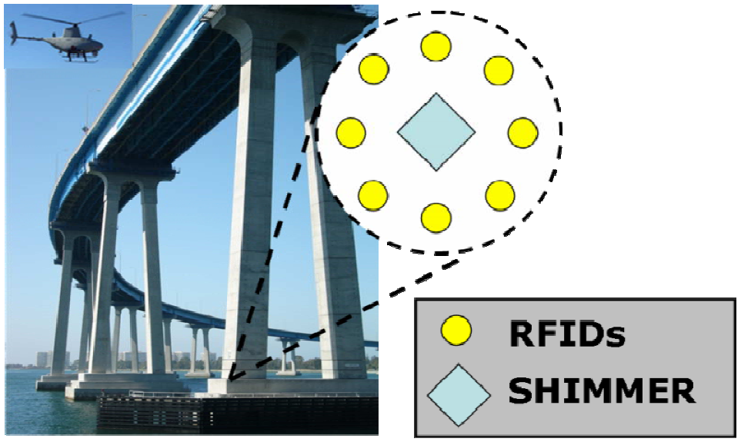
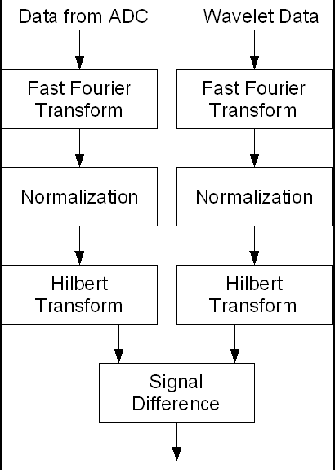
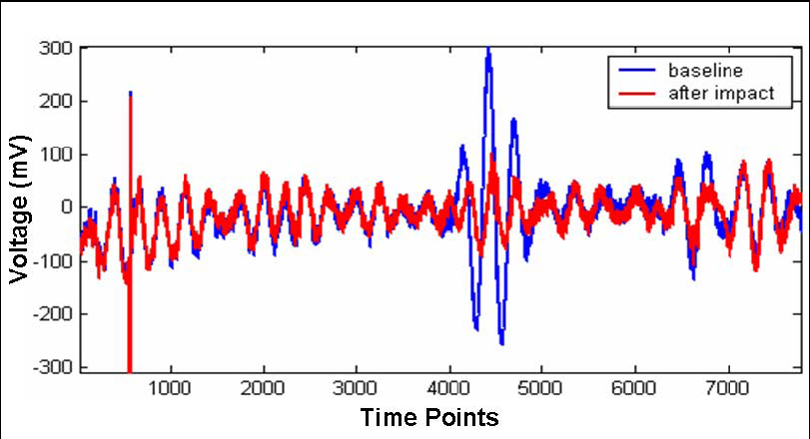
Related Work - SHIMMER
SHIMER project by the Los Alamos National Lab

Slide 7
Problem Description
Damage localization in addition to detection
Limited Resource on WSN node
  Limited memory
  Limited transmission bandwidth
  Limited power supply
Unreliable wireless connectivity

Slide 8
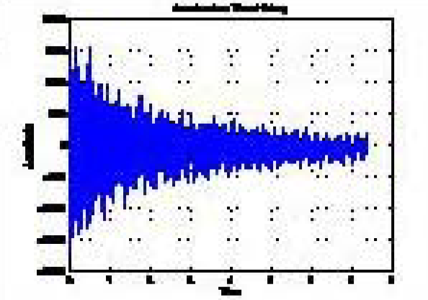
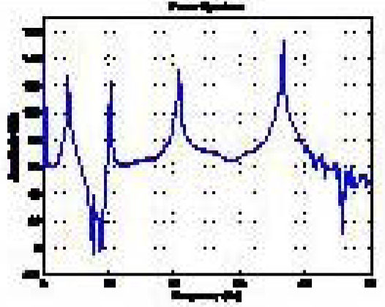
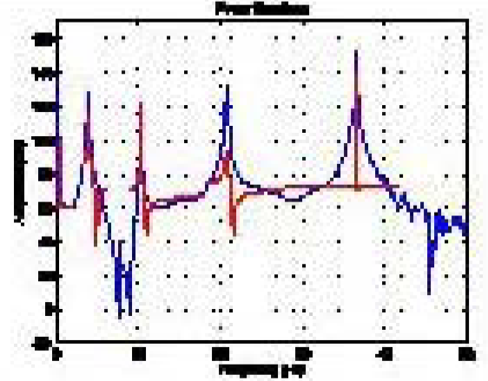
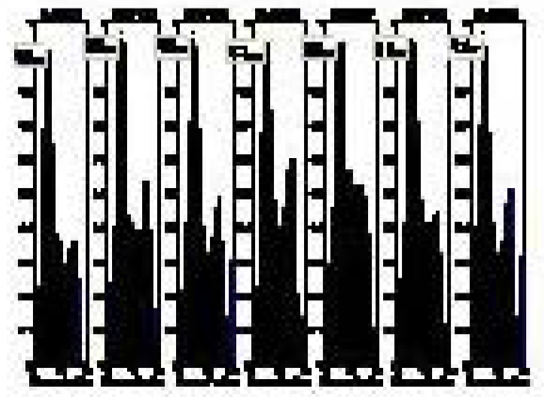
DLAC Algorithm
Acceleration Data
FFT
Power Spectrum
Curve Fitting
Healthy Model
DLAC
Damage Location

Slide 9
System Design
2048 Samples @560Hz
(4KB Data)
Processing on motes
FFT
Processing on PC
2048 Samples in Frequency Domain
(8KB Data)
Coefficient Extraction
Power Spectrum
5x5 = 25 coefficients
(50 Bytes Data)
1024 Frequency Spectrums
(2KB Data)
Equation Solving
Curve Fitting
5 Natural Frequencies
(10Bytes Data)
Healthy Model
DLAC
Damaged Location

Slide 10
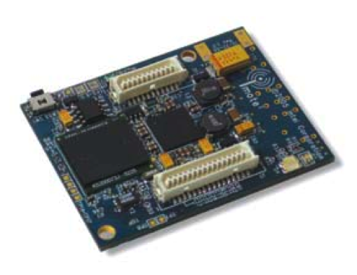
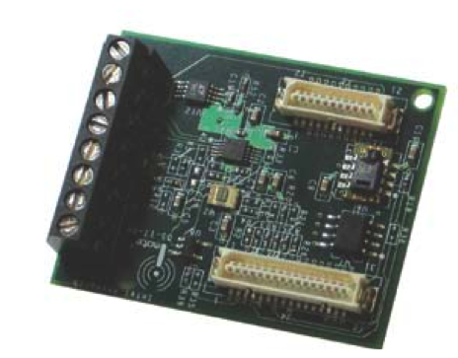
Implementation
Hardware
  Intel Mote 2
    32-bit 416 MHz CPU
    32MB RAM
  Intel ITS400 Sensor Board
    LIS3L02DQ 3-Axis Accelerometer
Software
  TinyOS
  NesC
IMote2
ITS400 Sensor Board

Slide 11
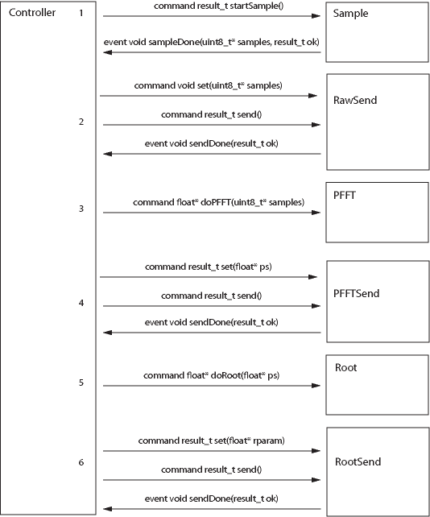
Software Architecture
Reliable data transmission done through ARQ
Average on the power spectrums to reduce noise
Often times, the sensor board driver crashes and never returns a sampleDone event
  Time out timer used to detect and bypass such scenario

Slide 12
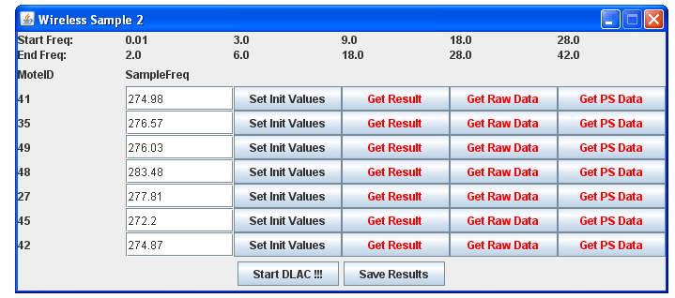
User Control Interface

Slide 13
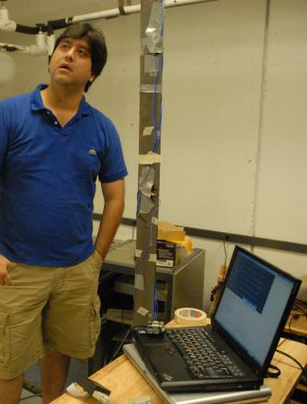
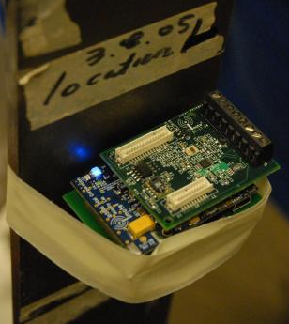
The Beam Test
The beam structure
in the Earthquake Lab

Slide 14
Beam Results
Successful damage detection and localization for all damage scenarios
  With correlation measurements >90% at the damaged positions
Damage Location #5
Damage Location #10
Damage Location #14

Slide 15
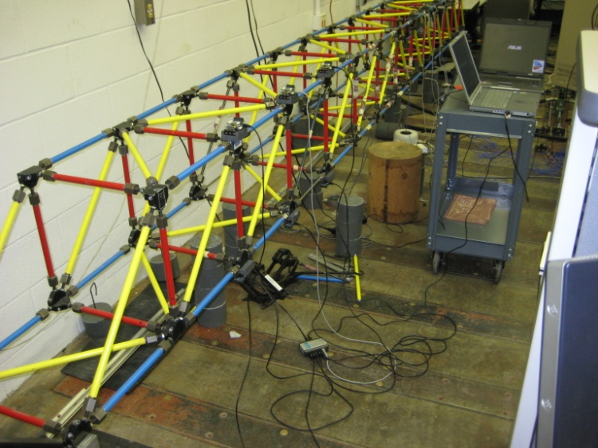
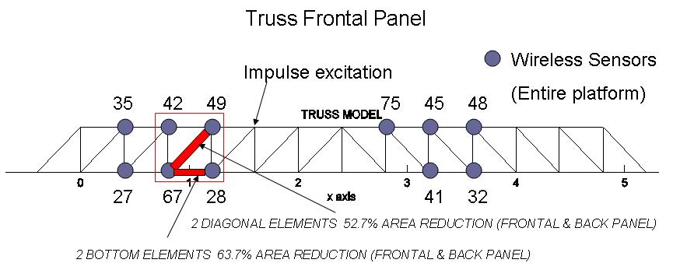
The Truss Test
The truss structure at UIUC

Slide 16
Truss Results
Successful damage detection and localization for all damage scenarios
  With correlation measurements >85% at the damaged positions
Damage Location #3

Slide 17
Conclusion
Design and Implementation of a SHM damage detection and localization technique on WSNs
  correlation-based and decentralized
Successful damage localization for two sets of experiments
Future Work:
  Debug sensor failure
  Power Management

Slide 18
Appreciation
Dr. Chenyang Lu
Dr. Shirley Dyke
Nestor Castaneda
WUSTL WSN Group
WUSTL Earthquake Lab
Dr. Tomonori Nagayama

